Slide 1
Development Environment
Missing session lecture 1

Slide 2
To write c++ programs…
You need to
Write c++ code
Compile it (so that your computer can understand the code)
Execute the compiled program
You need appropriate tools!
there exists various options!!

Slide 3
IDE??
Integrated Development Environment
Supports almost every step to develop program!!
Coding
Debugging
Compiling & Releasing…
Extremely Convenient
only thing you need to do : write code and press compile button

Slide 4
IDE??
Example (for cpp development)
Visual Studio
Developed by Microsoft
Most powerful IDE
Standard development tool for Windows developers
CLion
Developed by Jetbrain
Supports almost every major OSs (linux / mac OS / Windows / …)
High productivity & Convenience

Slide 5
IDE Hazard
However, for novice programmers…
IDE equals to Disaster!!! (just my opinion…)
Why???

Slide 6
IDE Hazard
Slow update
Too many functionalities
Therefore, Too heavy
vulnerable to errors
Also, your laptop has limited memory & CPU resources…
save them!!
(IMPORTANT) HARD TO understand
The fundamentals of programming
how your computer works

Slide 7
Your OWN Dev environment
Therefore, you need to setup your own dev environment!!!
This will help you
to understand the entire process of programming
to earn background knowledge to study computer system
to customize your DEV ENVIRONMENT (most attractive feature)
And will help your computer
to save its resources
to be sensitive to latest techs (by setting & updating the environment on your own)

Slide 8
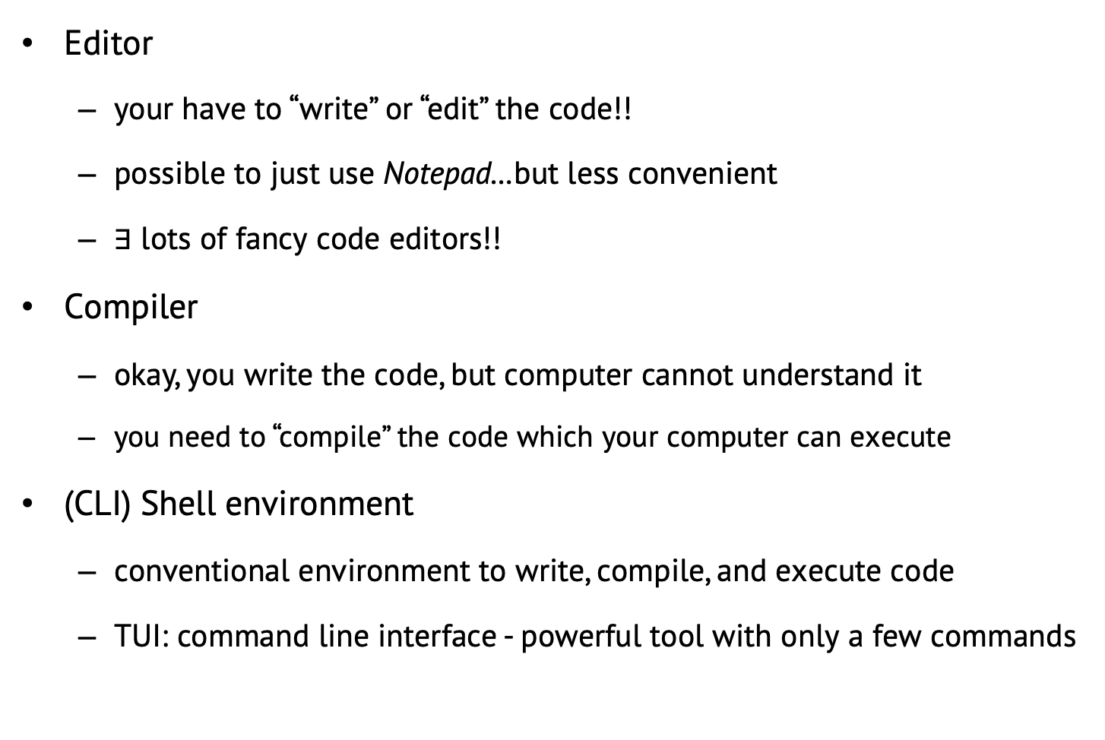
Basic components to develop something
Editor
your have to “write” or “edit” the code!!
possible to just use Notepad…but less convenient
$∃$ lots of fancy code editors!!
Compiler
okay, you write the code, but computer cannot understand it
you need to “compile” the code which your computer can execute
(CLI) Shell environment
conventional environment to write, compile, and execute code
TUI: command line interface - powerful tool with only a few commands

Slide 9
Why we need them?
your_code.cpp
Compiler
binary code
(executable!!)
SHELL ENVIRONMENT

Slide 10
In this course
In this course, I recommend to use
editor
Visual Studio Code
Compiler
gcc compiler
Shell
Window : command prompt & mingw environment
Mac OS : iterm
Linux : Maybe your already an expert of customizing dev environment..

Slide 11
Visual Studio Code
Developed by Microsoft, released in 2016
Currently, “Most famous” code editor
Platform-free
supports Linux, mac OS, Windows
Powerful extension environments
customize your own editor!!
supports almost all major programming languages
you can even develop your own extension
* Visual Studio Code is not Visual Studio!!

Slide 12
GCC Compiler
GNU Compiler Collection
initially developed by Richard Stallman
open source, free, multi-platform
supports
c, cpp, objective-c, objective-cpp
Fortran, Java, Go, Pascal
and else…

Slide 13
Shell / OS
Shell
What is shell?
User interface for access to an OS’s services (Wikipedia)
Actually, part of OS
So, to understand shell, you must know the basic of OS!!
OS (Operating System)
Manages computer hardware resources (CPU, memory, HDD…)
Manages processes / programs
Provides file system (including directory, file, link(shortcut))

Slide 14
Shell / OS
USER
Shell
(Literally “shells” OS kernel)
OS Kernel
(supports the
functionalities of OS)
OS

Slide 15
Shell
You’re already using shell!!
Windows shell
Desktop, Start menu, Taskbar, Explorer…

Slide 16
Shell
In this course, we’ll use CLI shell!!
Maybe familiar to CS students

Slide 17
CLI Shell
Convenient, light, and fast
If you become familiar…
Can manage entire OS / Dev environment
with only few commands
for beginners: ls, cd, and cat commands are sufficient!!
we’ll see them soon

Slide 18
Let’s start the setting!!

Slide 19
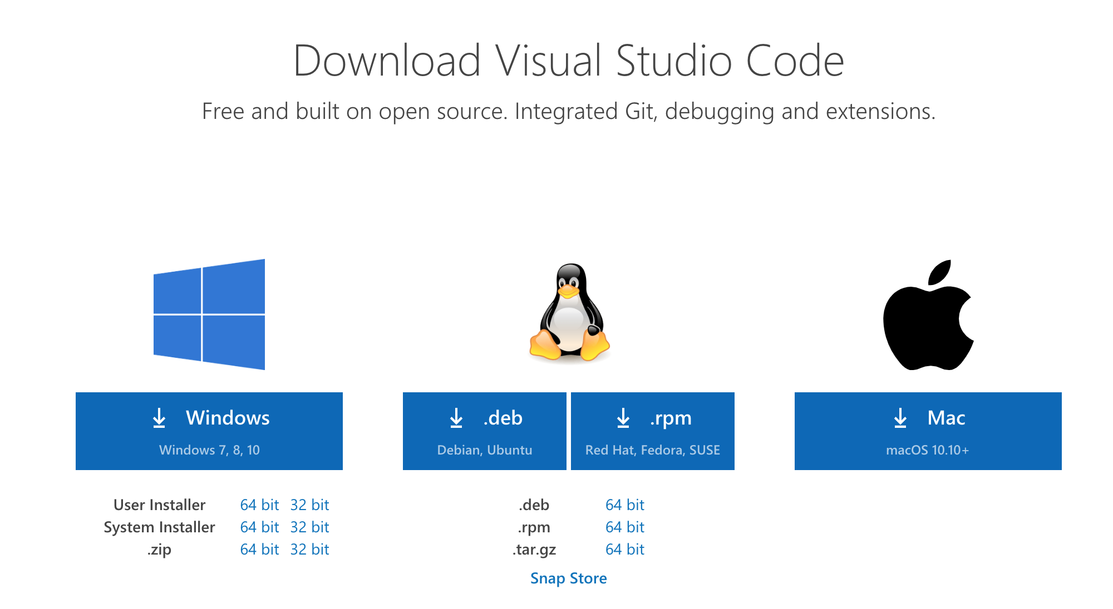
Visual Studio code
Reference official download page (Very easy)
https://code.visualstudio.com/download

Slide 20
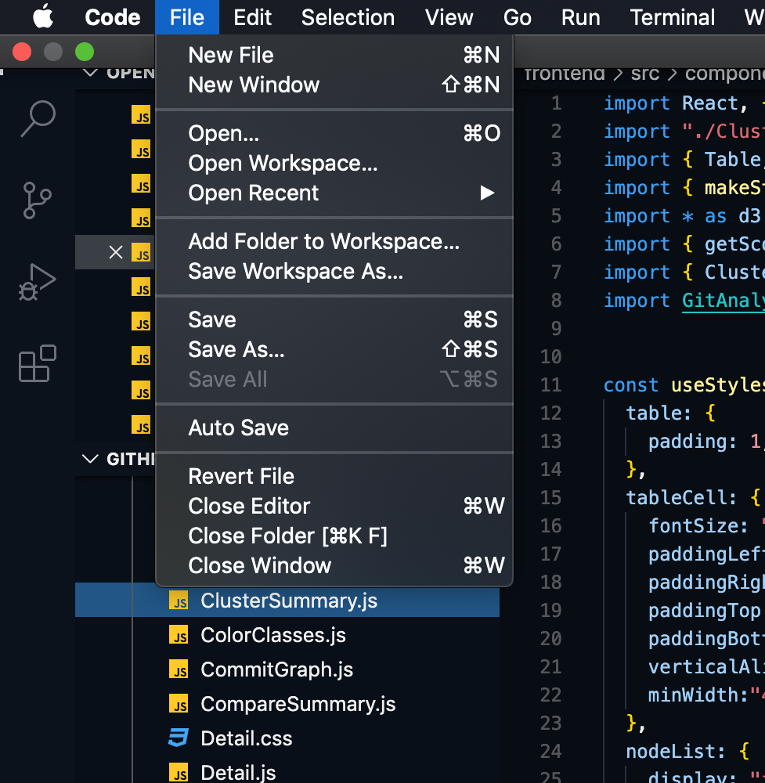
Visual Studio code
Select working directory by accessing File >> Open menu
Now you’re free to use the editor!!

Slide 21
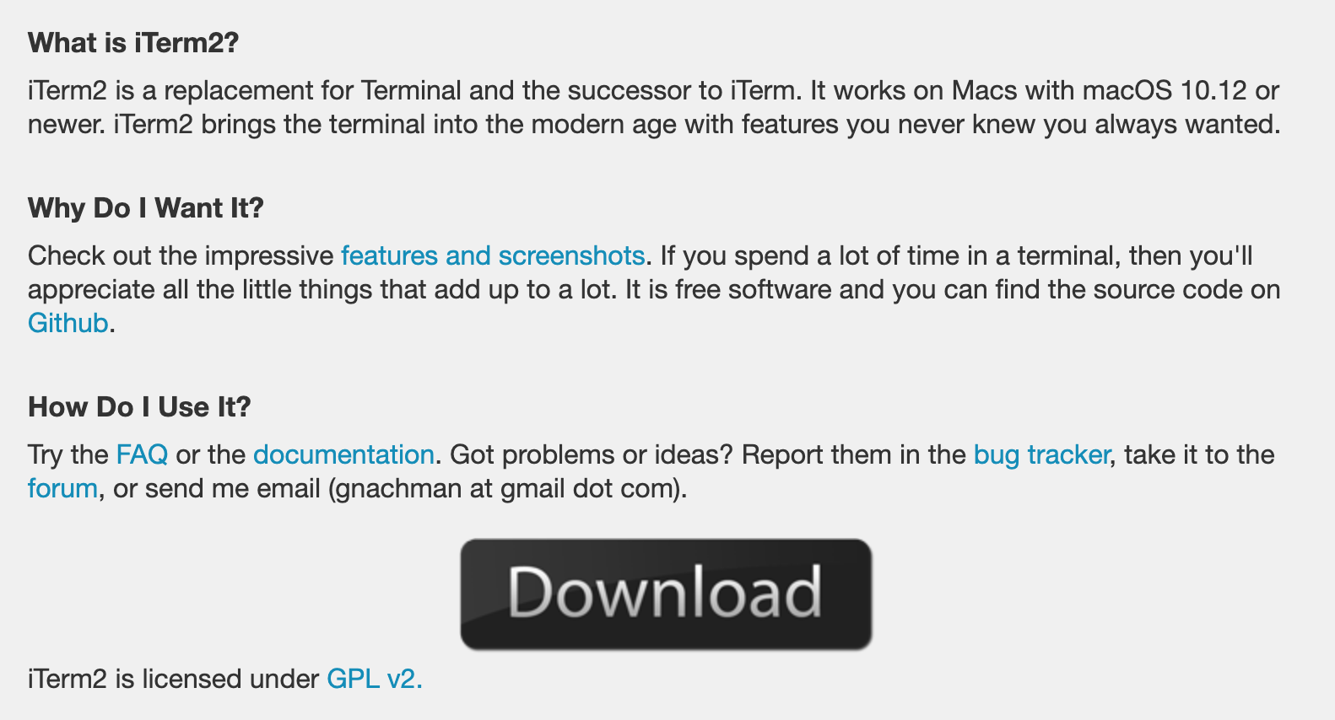
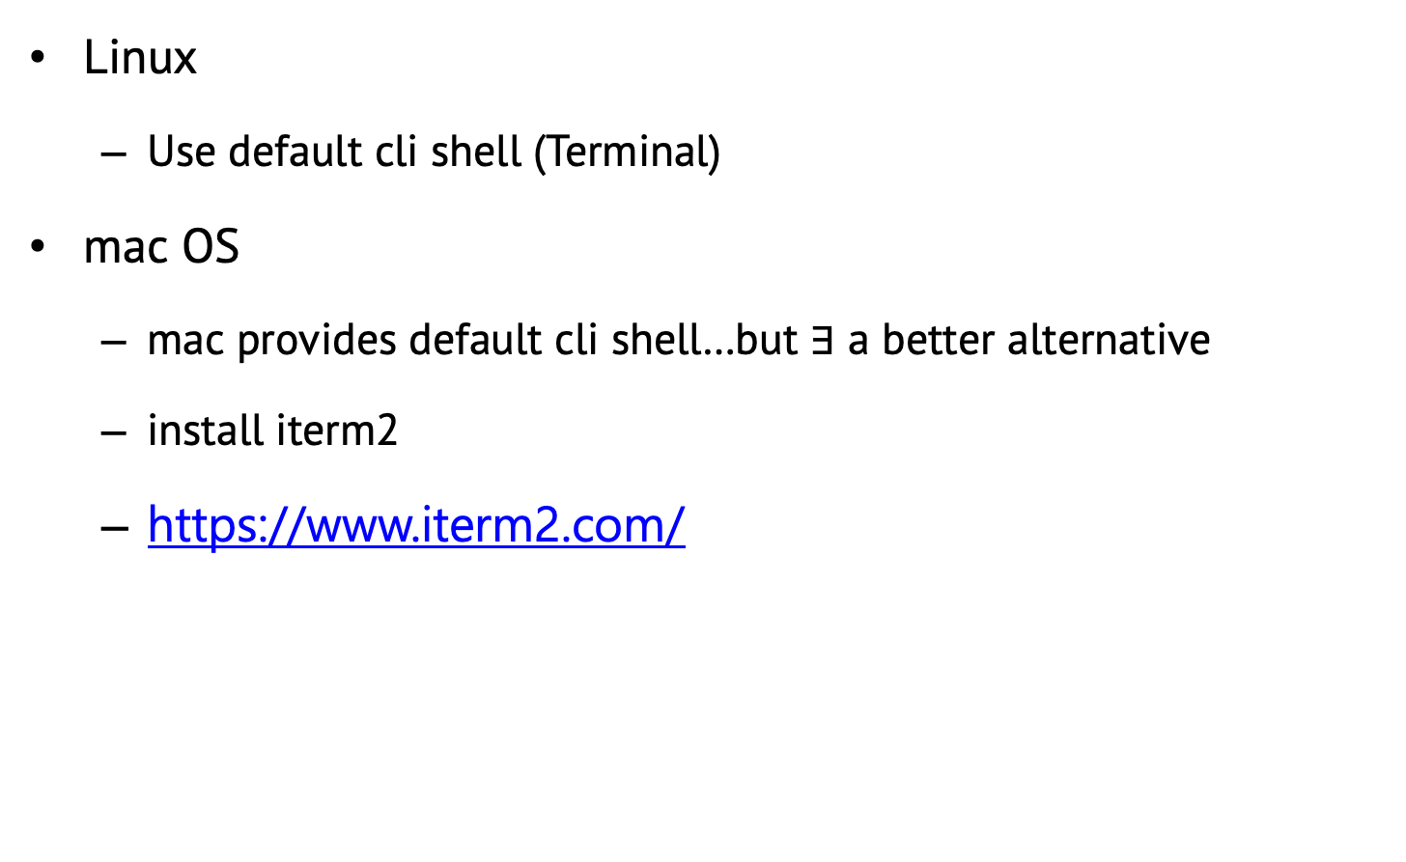
Shell
Linux
Use default cli shell (Terminal)
mac OS
mac provides default cli shell…but $∃$ a better alternative
install iterm2
https://www.iterm2.com/

Slide 22
Shell
Windows
use “command prompt” (already installed)
press (⊞ Window key) + R and type “cmd”
reference https://www.lifewire.com/how-to-open-command-prompt-2618089

Slide 23
GCC compiler environment
Linux
https://linuxize.com/post/how-to-install-gcc-compiler-on-ubuntu-18-04/
mac OS
open iterm2 terminal (cli shell)
install ”brew”
paste this command in the terminal
/bin/bash -c "$(curl -fsSL https://raw.githubusercontent.com/Homebrew/install/master/install.sh)”
install “gcc”
run the command: brew install gcc
check whether the installation finished successfully or not by
running the command: gcc -v

Slide 24
GCC compiler environment
Windows
we’ll use MinGW!!
Minimalist GNU for Windows
provides GCC compiler for Windows
you should first install MinGW, and then integrate it to Windows
http://www.mingw.org/wiki/Getting_Started
Follow the instruction!!
Korean ver: https://mingtrace.tistory.com/446

Slide 25
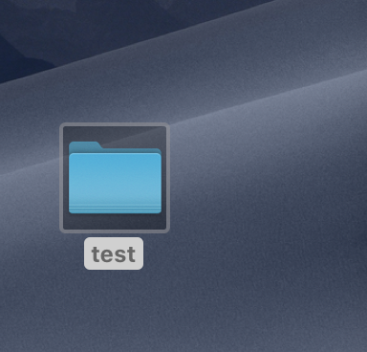
Okay, let’s test the environment!
Make test directory in your desktop
Execute visual studio code, and open the directory:
Path will be similar to ~/Desktop/test

Slide 26
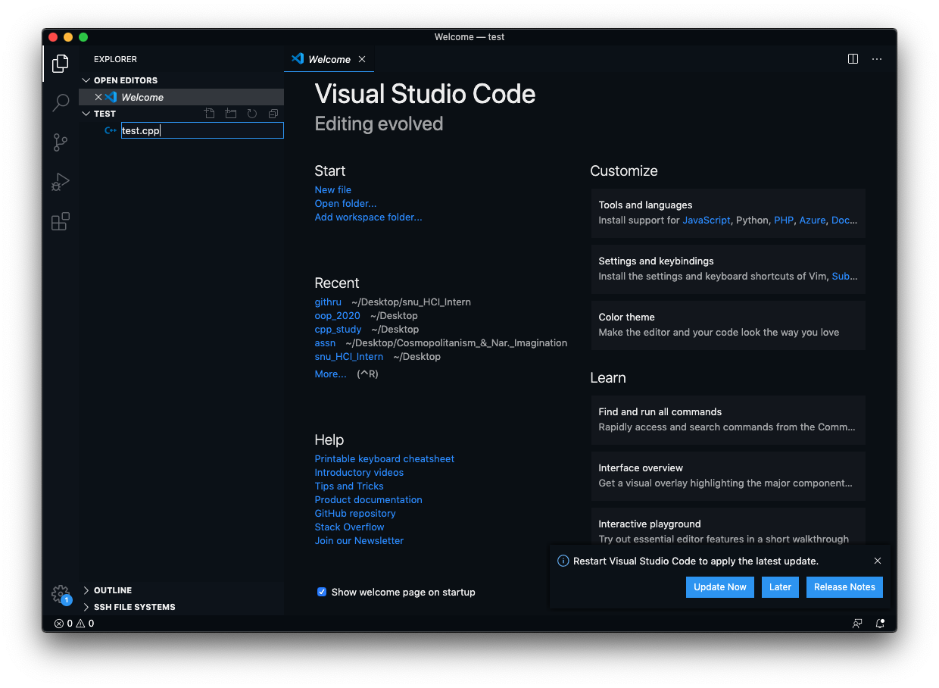
Okay, let’s test the environment!
select “new file” icon and create new file: “test.cpp”

Slide 27
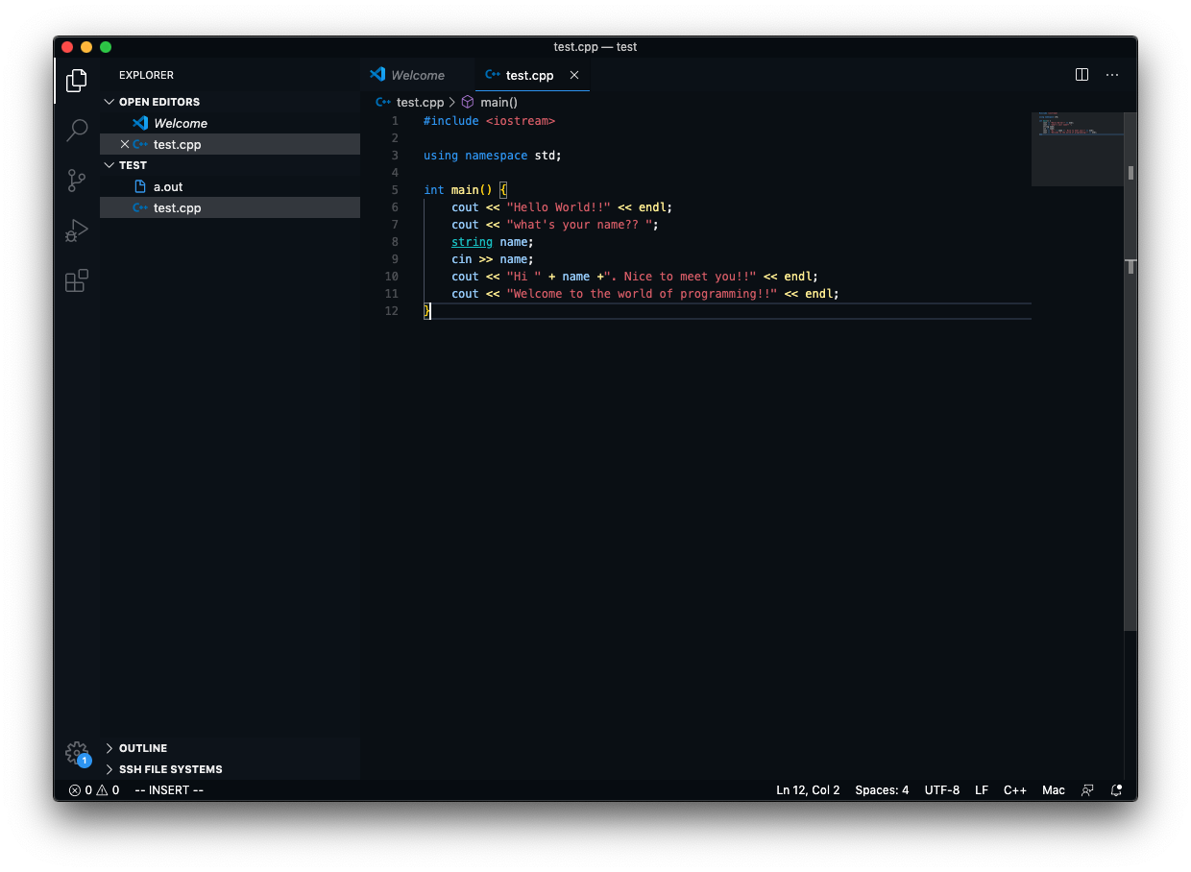
Okay, let’s test the environment!
Write Test code
The code is available in :

Slide 28
Subtitle
Notes

Slide 29
Subtitle
Notes

Slide 30
Subtitle
Notes

